Slide 1
Special Education Preschool Program
Corona-Norco Unified School District
Presented by: Lori Gerhart
Nicole Robertson
Notes:
Lori

Slide 2
CNUSD Preschool Program Eligibility
CNUSD Preschool Program serves students ages 3-5 that meet any of the Special Education eligibility categories including:
-Speech or Language Impairment -Other Health Impairment
-Intellectual Disability -Specific Learning Disability
-Hard of Hearing -Traumatic Brain Injury
-Deafness - Deaf-Blindness
-Visual Impairment -Multiple Disability
-Emotional Disturbance -Autism
-Orthopedic Impairment
Notes:
Lori

Slide 3
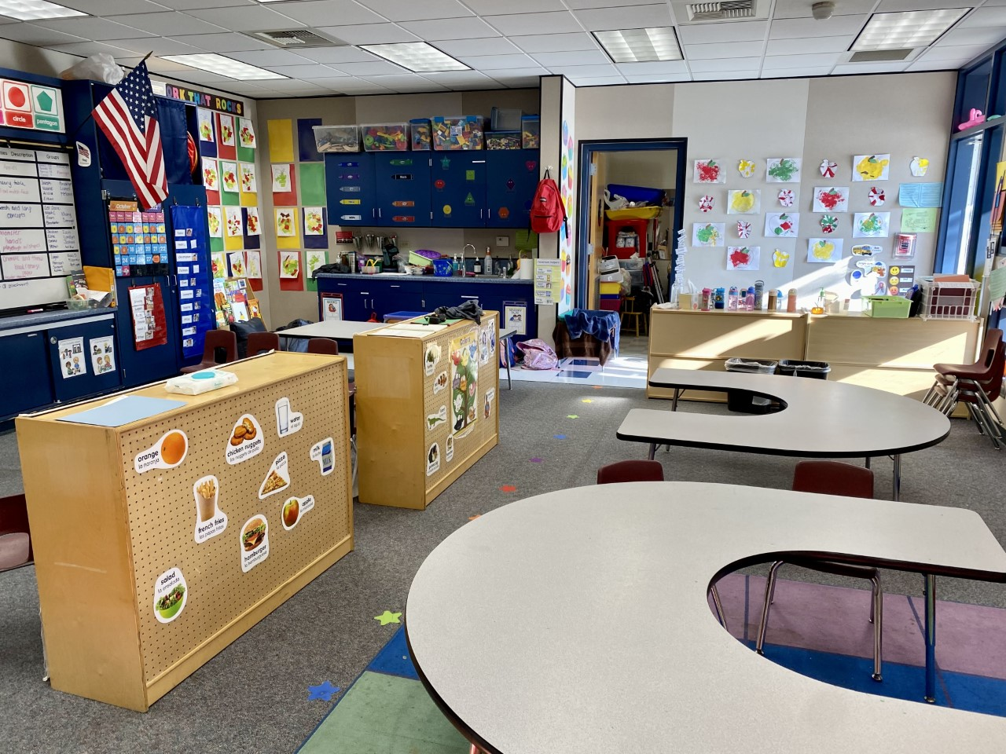
Continuum of Preschool Programs:
Least to Most Restrictive:
-Walk In Services
-4 Day Special Education Preschool Program including DHH Program
-5 Day Special Education Preschool Program
-PALS: Special Education Autism Specific Program
CNUSD offers services for student in the Least Restrictive Environment determined by the IEP team.
Notes:
Lori

Slide 4
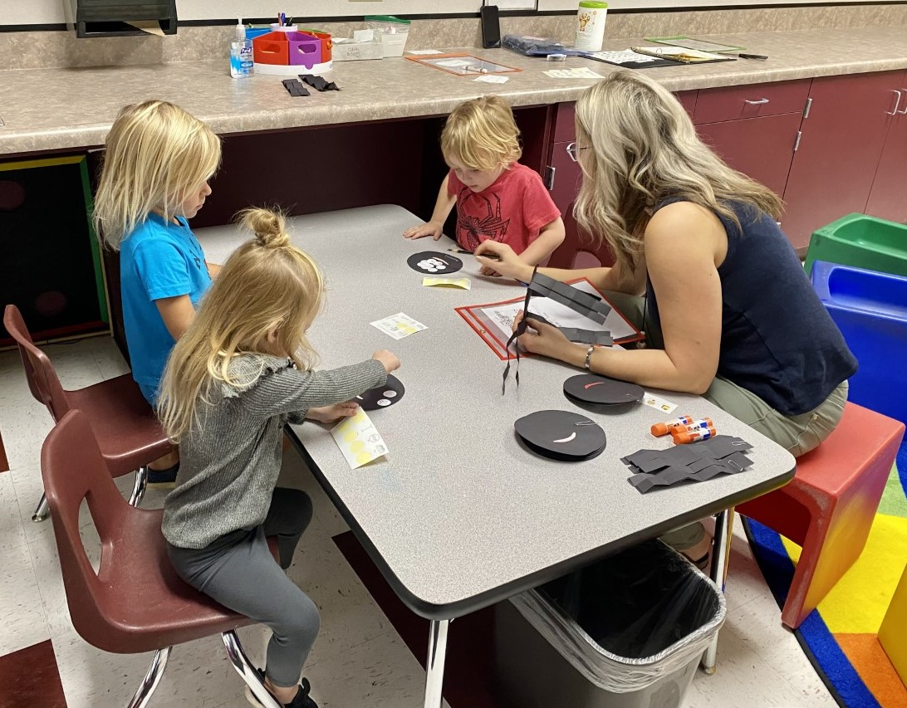
Walk-In Services
Services (i.e. Speech-Language services, Adapted Physical Education services, Occupational Therapy services, and/or Physical Therapy services) are provided to students in a “walk-in model” based on specific need of students. Students that receive walk-in services do not require Specialized Academic Instruction.
Notes:
Lori

Slide 5
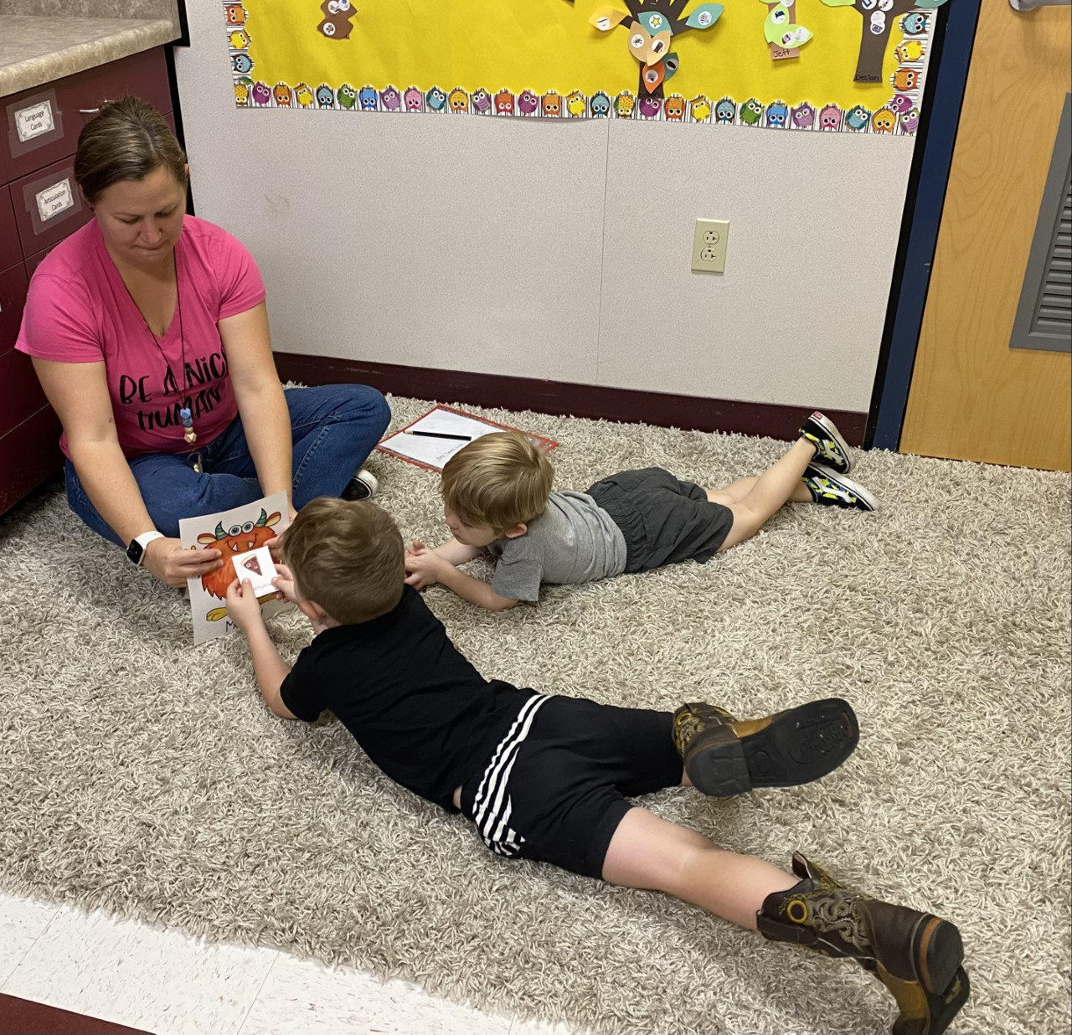
Speech-Language Services
Areas of focus may include:
-speech sound production
-fluency
-voice
-receptive/expressive
language
-pragmatics
Notes:
Lori

Slide 6
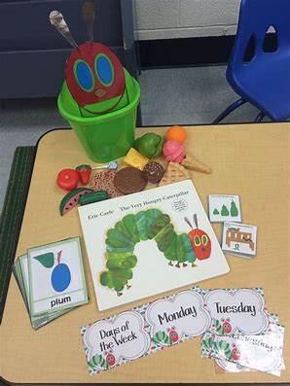
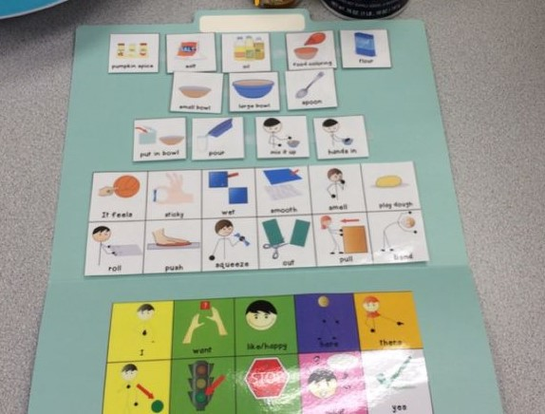
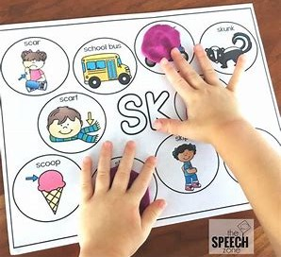
Locations of Walk-In Services:
-Coronita Elementary School
-Foothill Elementary School
-Rondo School of Discovery
-Temescal Valley Elementary School
Notes:
Lori

Slide 7
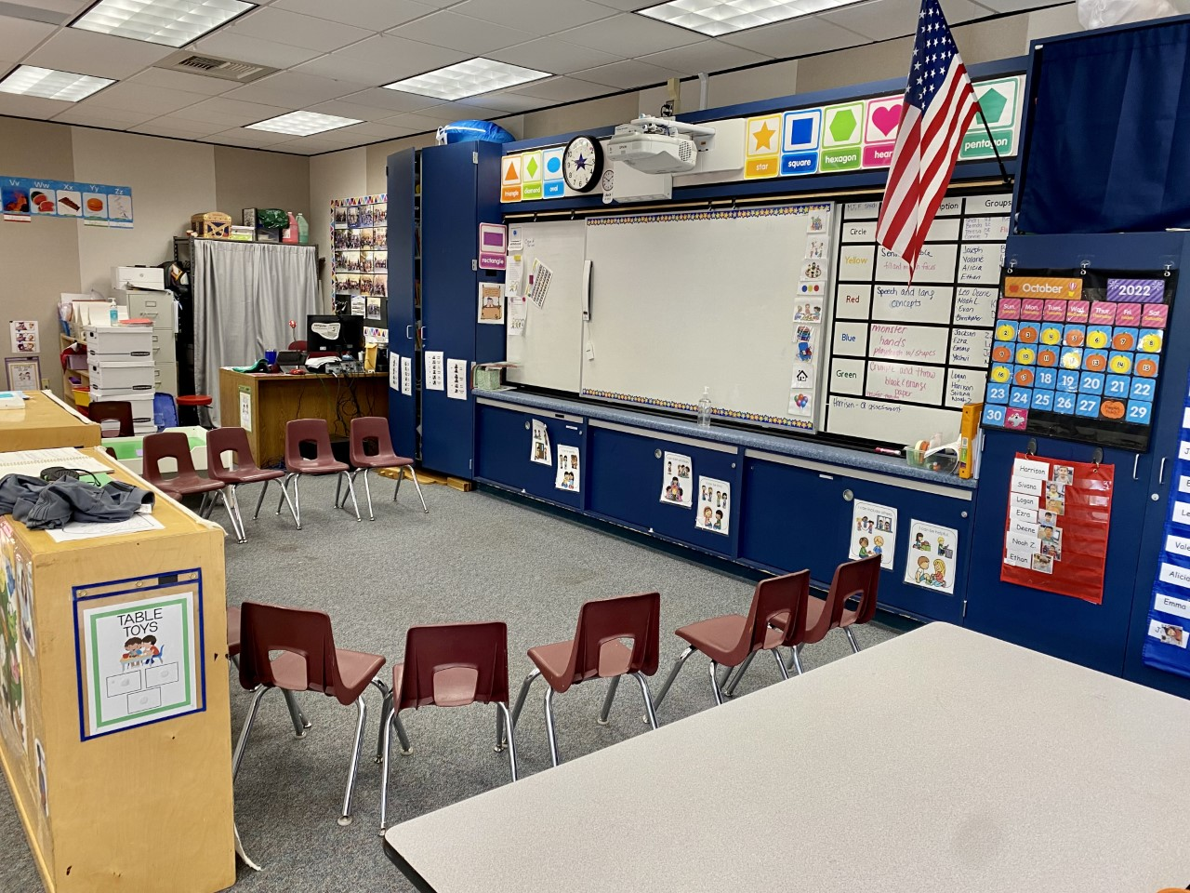
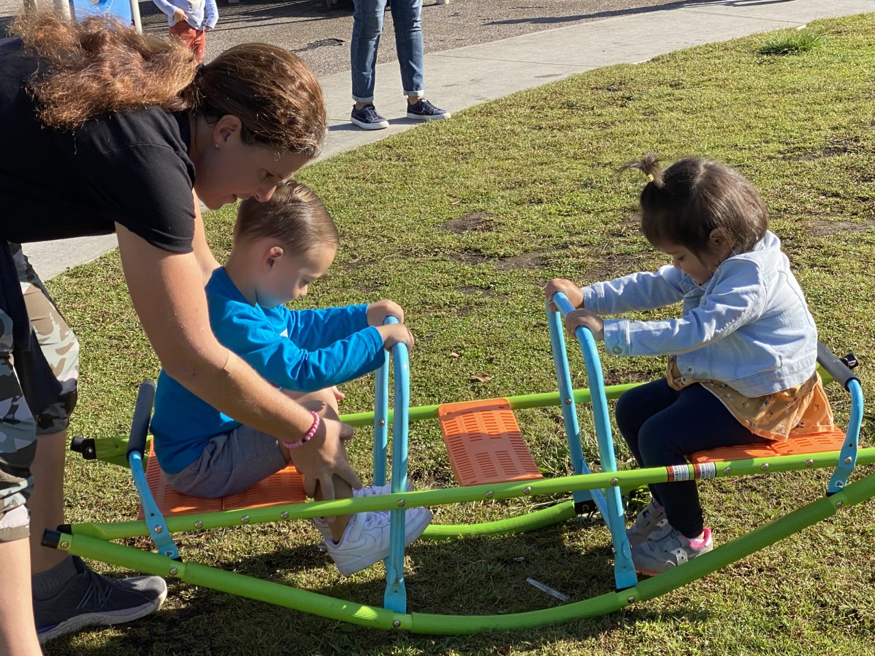
4 Day Special Education Preschool Program
Non-categorical special education preschool program for students that require Specialized Academic Instruction and related services.
Notes:
Nicole

Slide 8
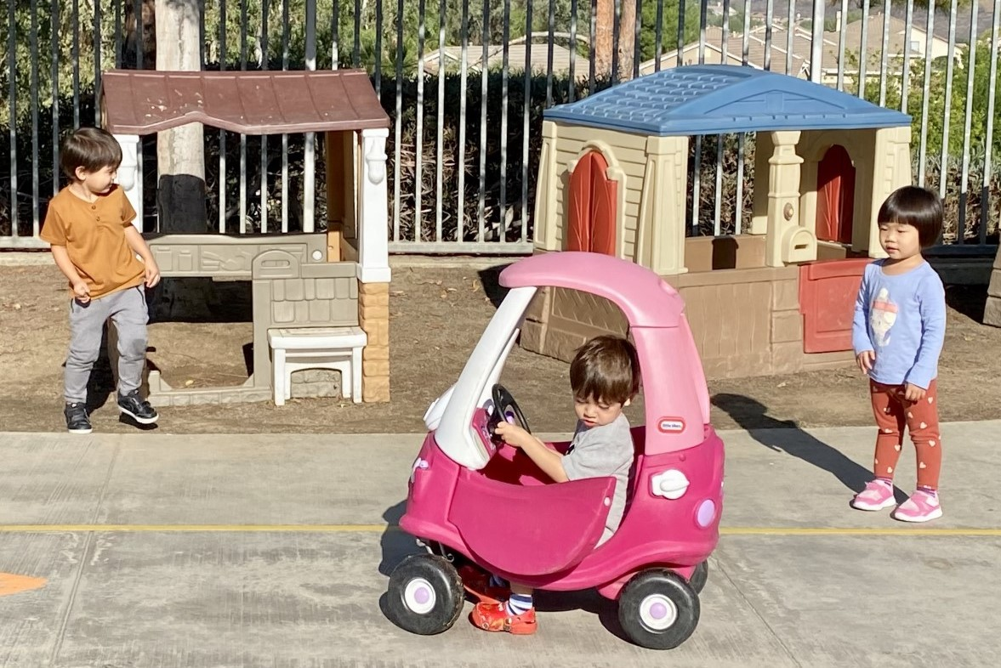
4 Day Preschool Continued
Learning activities are developed based on Preschool Learning Foundations, Desired Results Developmental Profile, and individualized IEP goals.
Areas of focus include:
Language and communication
Social-emotional development
Pre-academics
Motor skills
Etc.
Notes:
Nicole

Slide 9
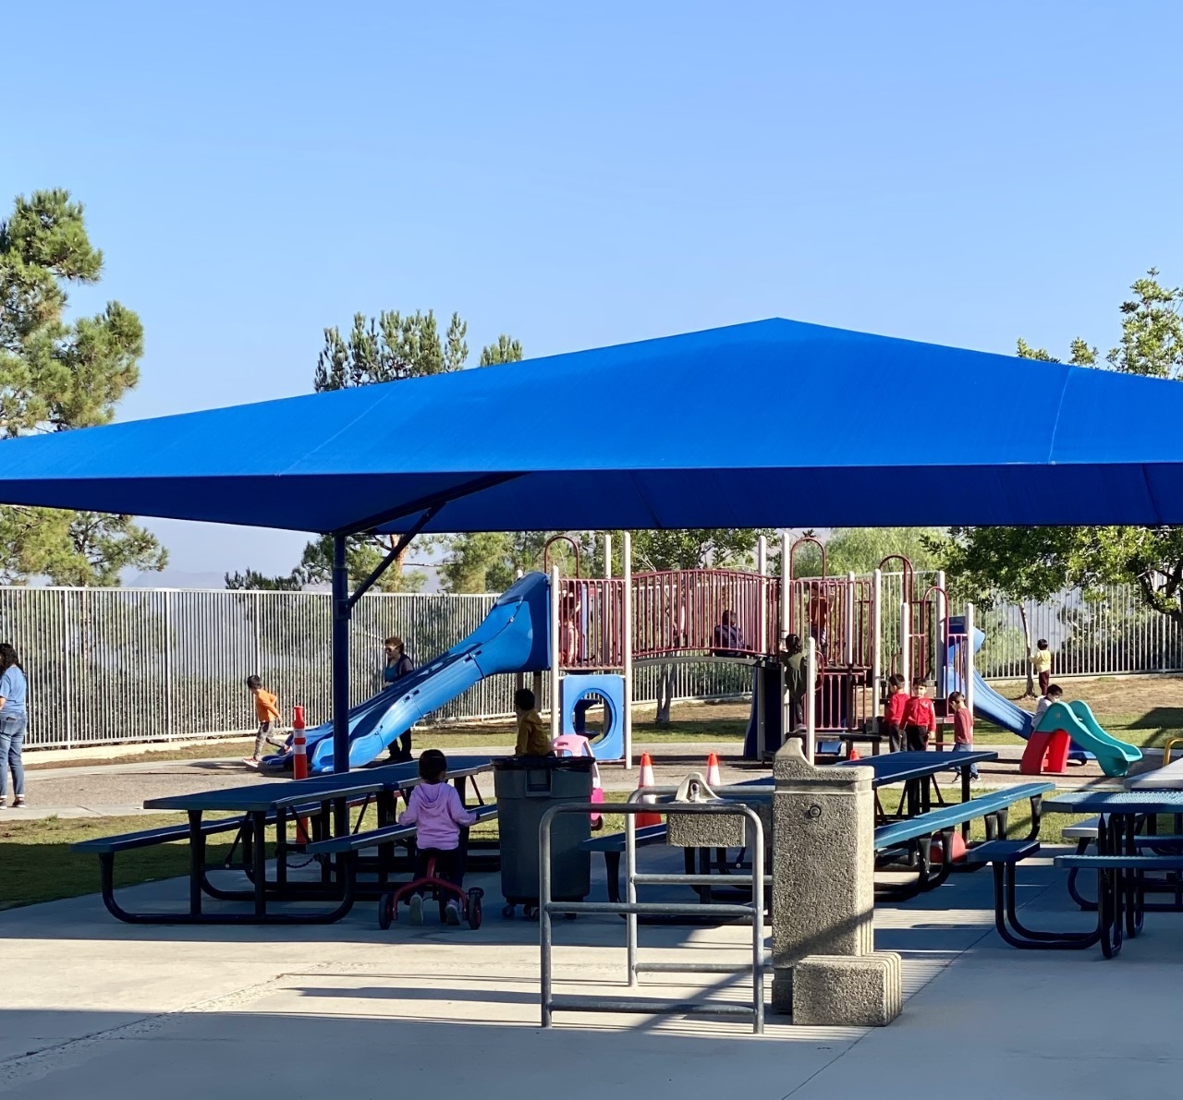
Locations of 4 Day Special Education Preschool
-Coronita Elementary School
-Foothill Elementary School
-Temescal Valley Elementary School
-Riverview Elementary School
Notes:
Nicole

Slide 10
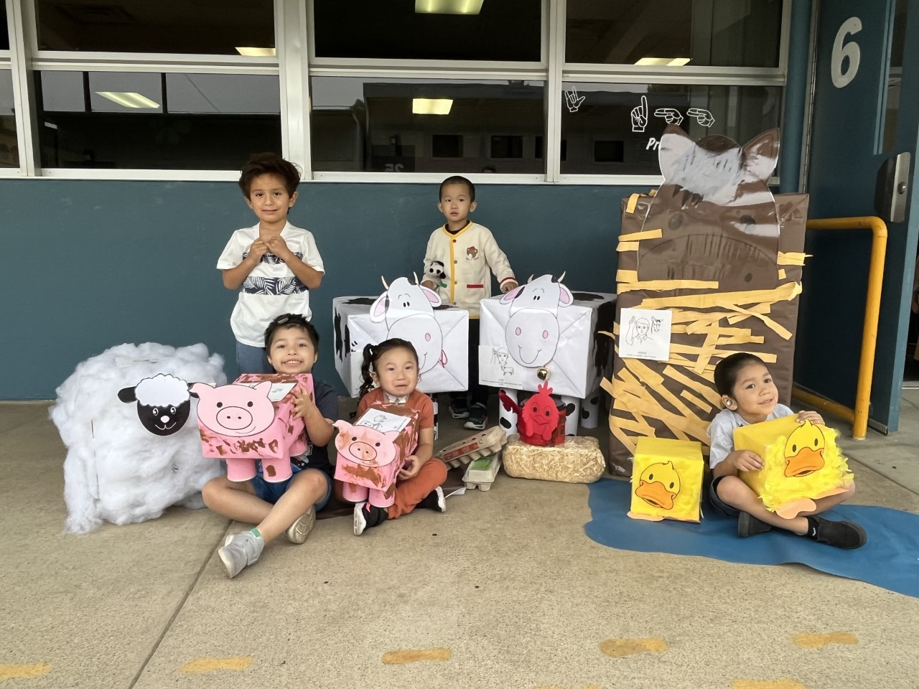
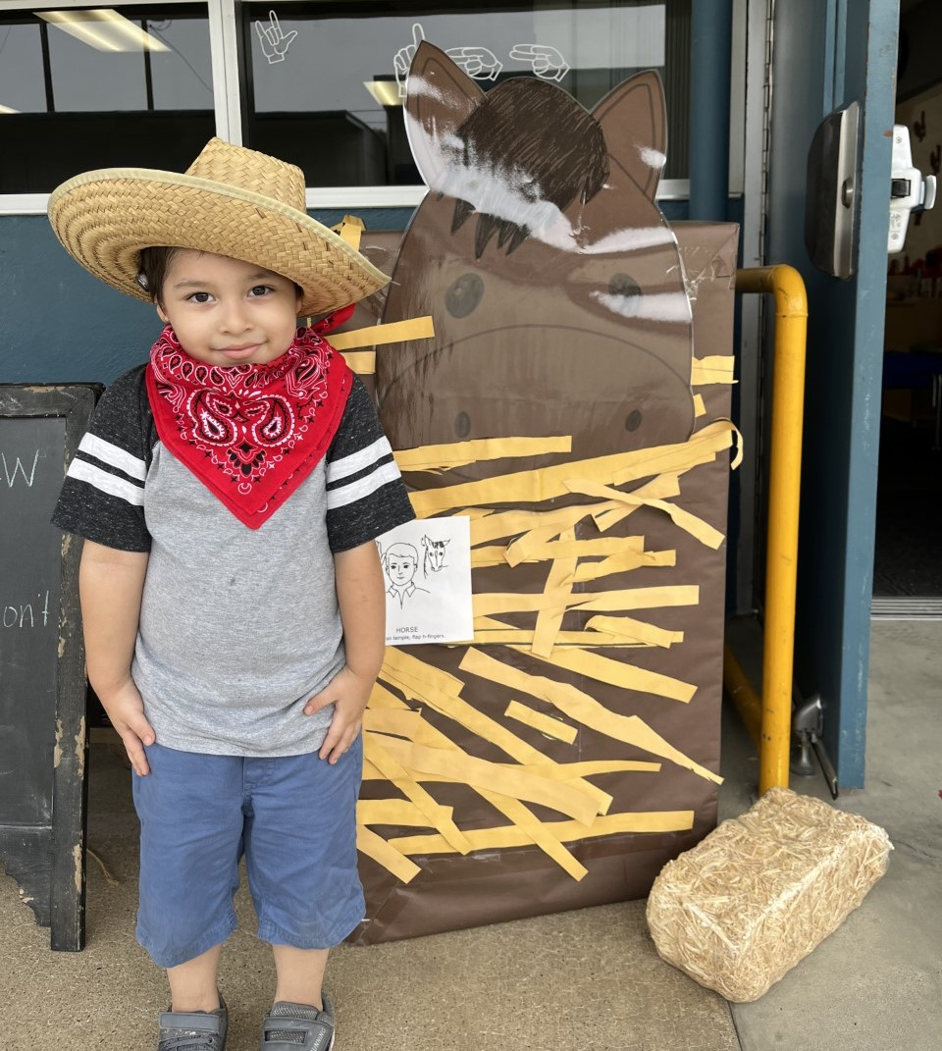
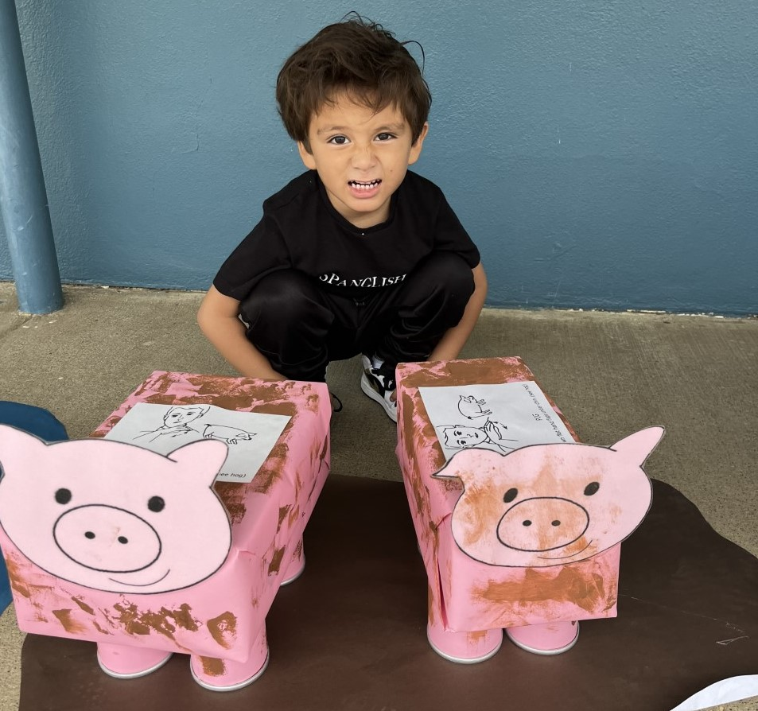
4 Day DHH Special Education Preschool Program
Special education preschool program for students that meet eligibility under Deaf or Hard of Hearing.
Location: Riverview
Elementary School
bility under Deaf or Hard of Hearing
Notes:
Nicole

Slide 11
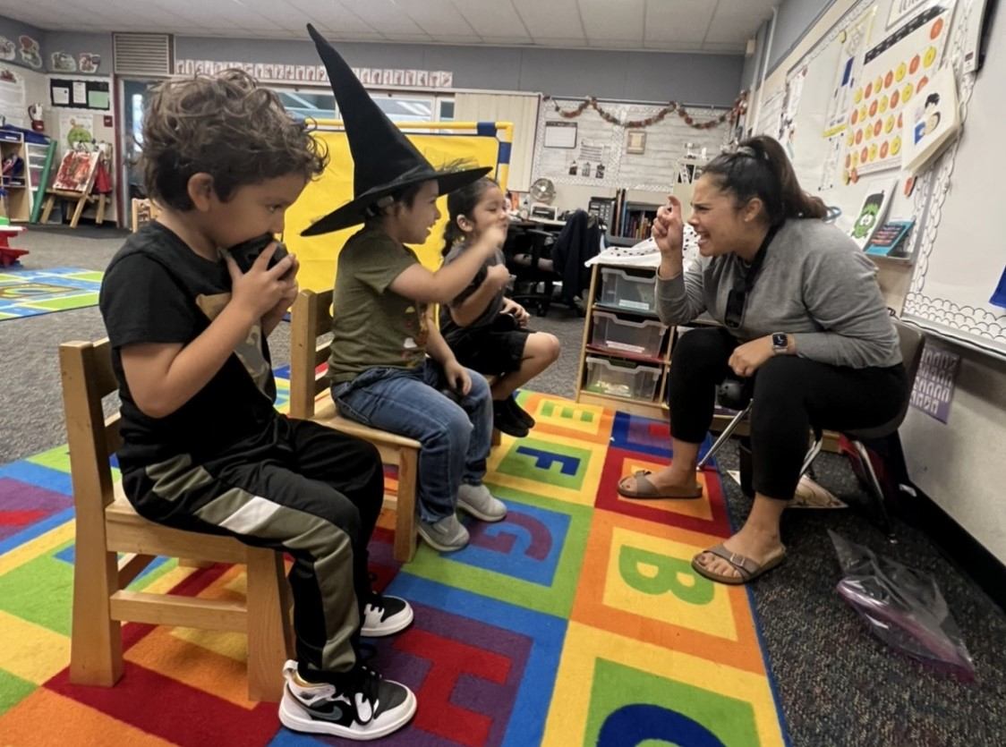
4 Day DHH Preschool Continued
Learning activities are developed based on Preschool Learning Foundations, Desired Results Developmental Profile, and individualized IEP goals.
Students are provided with multimodality communication including verbal language and sign language.
Notes:
Nicole

Slide 12
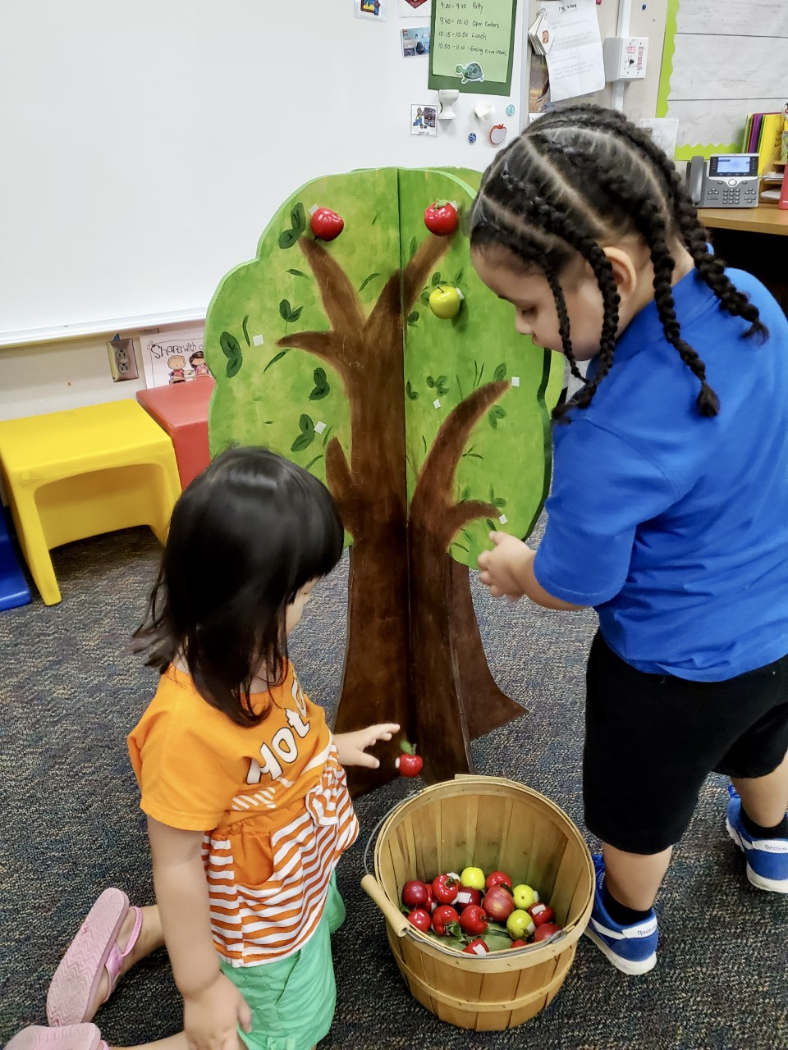
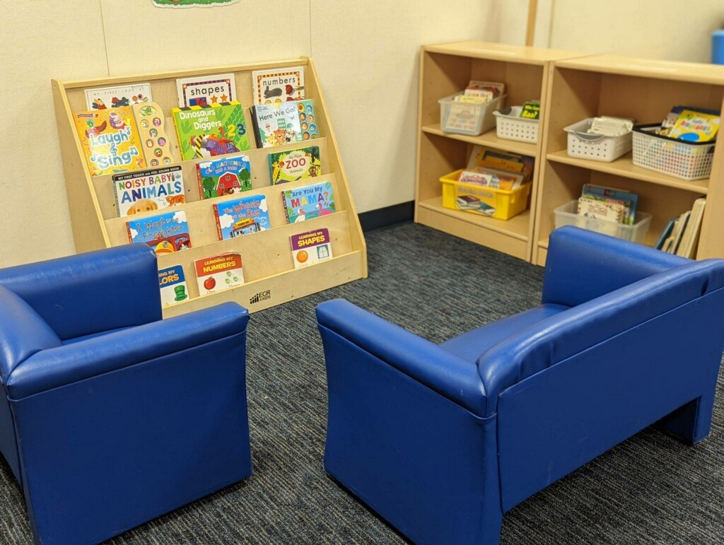
5 Day Special Education Preschool Program
Non-categorical special education preschool program for students that require Specialized Academic Instruction and related services. Students in this program require more intensive SAI services than the 4 Day Program.
Notes:
Nicole

Slide 13
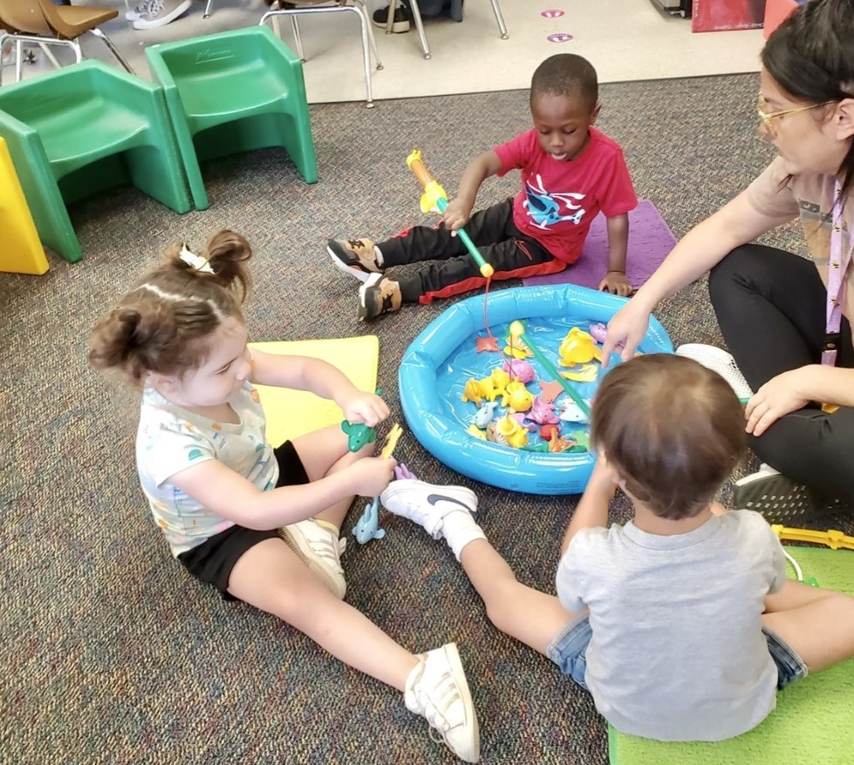
5 Day Preschool Continued
Learning activities are developed based on Preschool Learning Foundations, Desired Results Developmental Profile, and individualized IEP goals.
Areas of focus include:
Language and communication
Social-emotional development
Pre-academics
Motor skills
Attending/Participation
Students may be working on developing a multimodality communication system such as verbal language, signs, gestures, Picture Exchange Communication System.
Notes:
Nicole

Slide 14
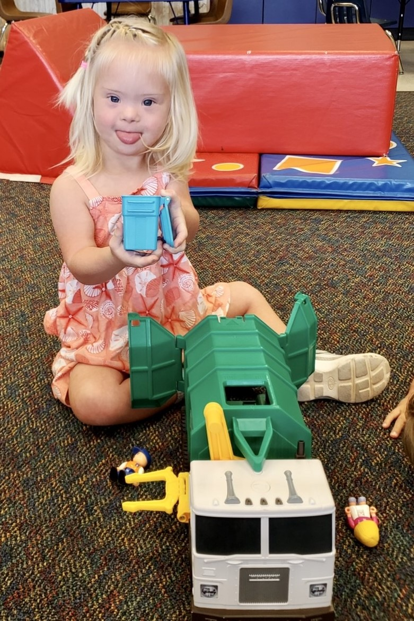
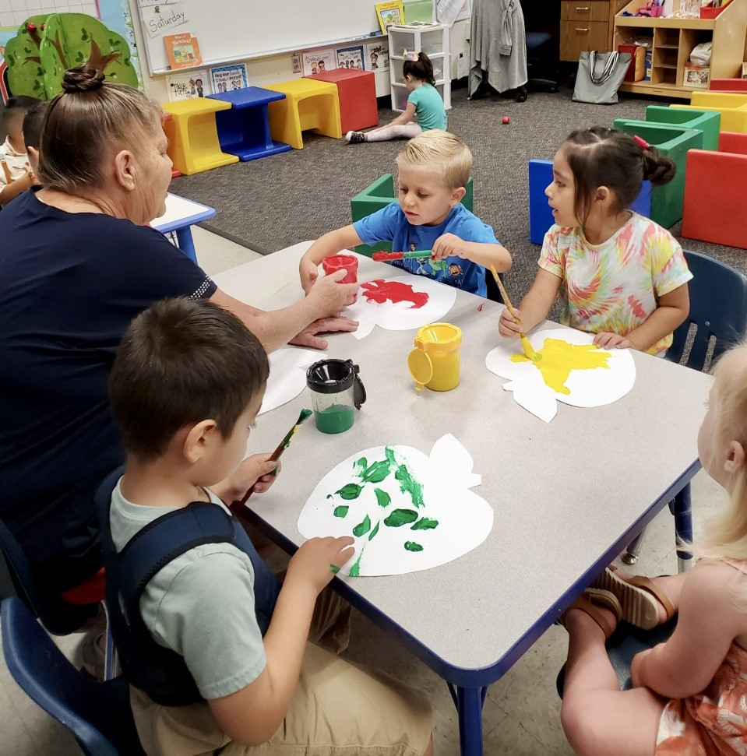
Locations of 5 Day Special Education Preschool
-Coronita Elementary School
-Foothill Elementary School
-Temescal Valley Elementary School
-Riverview Elementary School
-Victress Bower School for
Exceptional Students
Notes:
Nicole

Slide 15
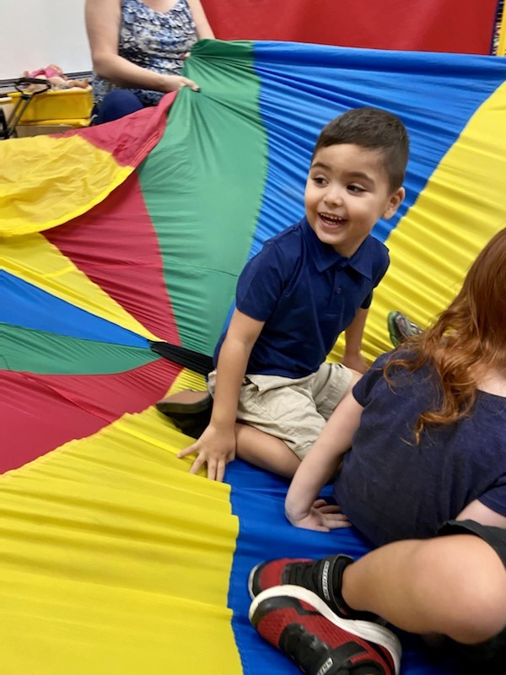
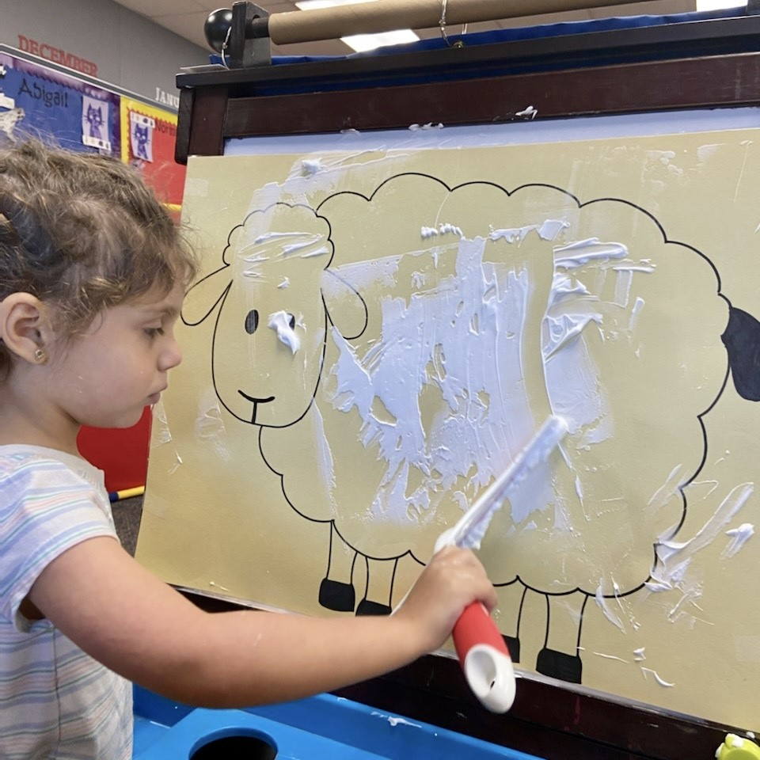
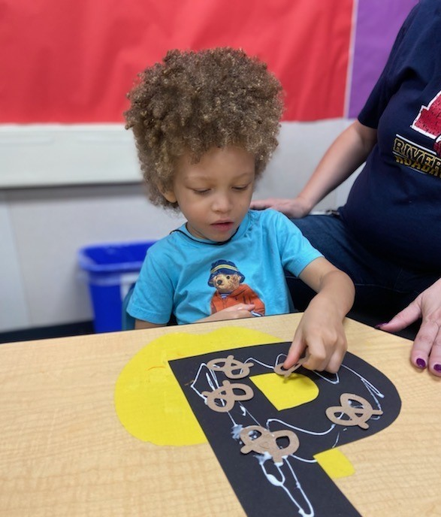
PALS Special Education Autism Specific Preschool Program
Special education preschool program designed for students with Autism that require a highly structured program with implementation of Evidence Based Practices for students with Autism.
Notes:
Nicole

Slide 16
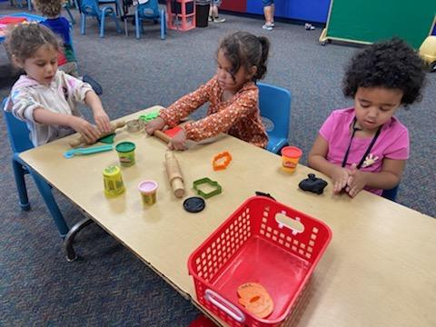
PALS Preschool Continued
Learning activities are developed based on Preschool Learning Foundations, Desired Results Developmental Profile, Unique Learning System, SANDI Assessment, and individualized IEP goals.
Areas of focus include:
Language and communication
Social-emotional development
Pre-academics
Motor skills
Attending and participation
Students may be working on developing a multimodality communication system such as verbal language, signs, gestures, Picture Exchange Communication System.

Slide 17
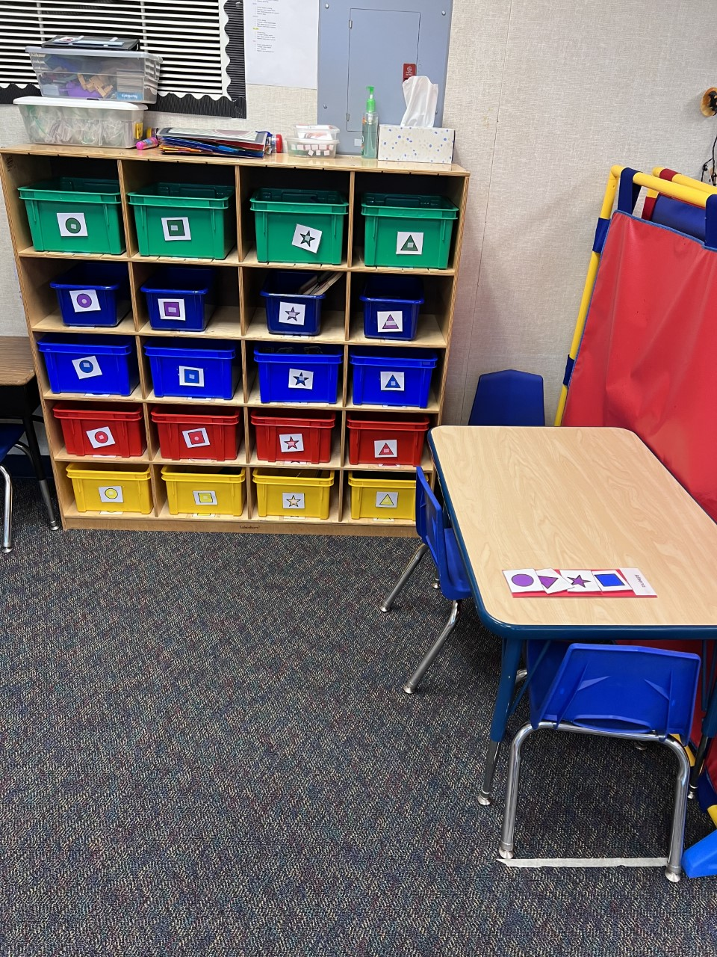
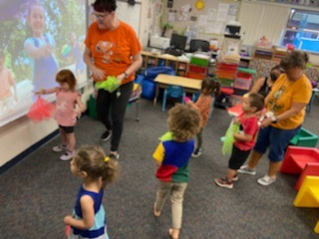
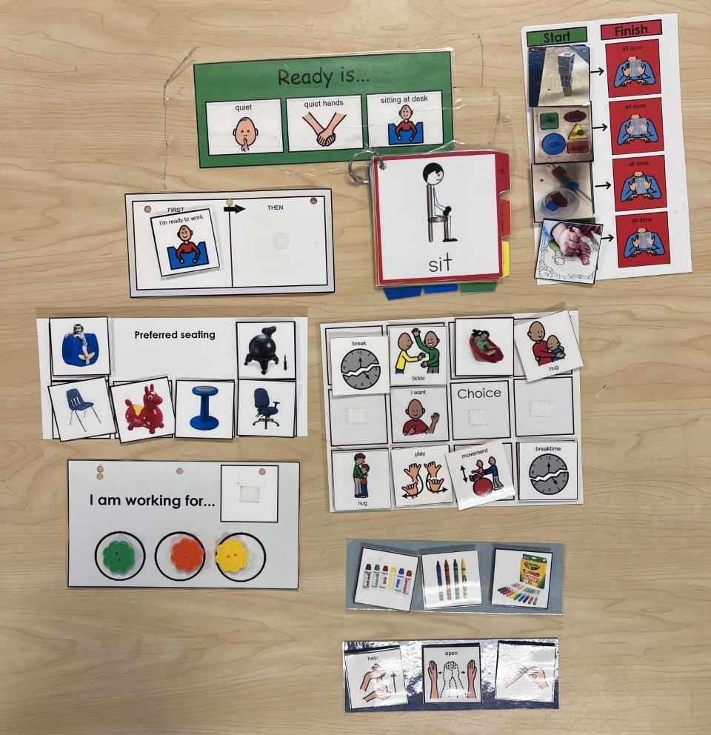
Locations of PALS Autism Specific Preschool
-Foothill Elementary School
-Riverview Elementary School
Notes:
Nicole

Slide 18
Preschool/ Part C Submitted Questions
What is the current Plan for District “Walk In”& “ Pay for Service”preschool?
Please see slide 4 -Walk in services
At this time the district does not have a plan to implement a Pay for Service preschool.
2. What is the district doing to increase LRE percentages for Part C students?
We offer a continuum of services in the Least Restrictive Environment from Walk-In to PALS . We meet the needs of all students so if there is another placement required, the IEP team will make that determination.
The state of California has changed the age for TK age requirements. In the year 2022-2023, students that turn 5 years old between 9/2-2/2 are eligible for TK. In the year 2023-2024, students that turn 5 years old between 9/2-4/2 are eligible for TK.In the year 2024-2025, students that turn 5 years old between 9/2-6/2 are eligible for TK.
Notes:
Lori

Slide 19
Preschool/ Part C Submitted Questions Continued
3. Has the District updated the preschool curriculum?
CNUSD is still in the process of determining which curriculum to adopt. All learning activities are based on the Preschool Learning Foundations, Desired Results Developmental Profile, and individualized IEP goals.
4. What percentage of initial [emphasis added] preschool IEPs have general education representation in attendance? How is that data being collected?
CNUSD does not have a general education preschool. We are still working on getting representation in all IEPs but we do have representation for students that attend the Head Start Program.
Notes:
Lori

Slide 20
Thank you for watching our preschool presentation
Notes:
Lori

